Slide 1
SCRABBLE MASTER
BY
Nauman Alam &
Syed Danish Hassan

Slide 2
Basic rules used to play Scrabble
The first player begins the game by placing a word on the star square (7, 7) either horizontally (right) Or vertically (down);
In each step the player can either enter a word of their choice or enter a blank word if they cannot think of one/skip their turn.
If a player makes a word on the board, we add up the respective point values for each of the letters used.
If a letter is in a double or triple letter space, we multiply the point value of that letter by 2 or 3.
If a letter is in a double or triple word space, we multiply the total score of that word by 2 or 3.
After the first turn, all words in each turn must have at least one letter that interlocks with previous words.
If a player adds a letter(s) to an existing word, they get the points for all the letters in that new word.
If there are a total of 6 collective turn skipped the game ends.
If the total tiles in the bag run out and the player has also run out of tiles, the game ends.

Slide 3
HOW WE CREATED THE GAME
We used classes to create this game
The main classes used were:
Tile- that keeps track of the tile letter and the tile value
Rack- that keeps track of the tiles in a player’s letter rack
Bag- that keeps track of the remaining tiles in the bag
Word- that checks the placement of the word and that if it is a valid word
Board- that keeps track of the tile’s location on the board

Slide 4
WHY WE USED CLASSES
With functions & Graphs code compilation and optimization was difficult but some prior knowledge and a similar project which ran successfully encouraged us to use classes
Classes essentially group functions (as methods) and data(as properties) which revolve around one key element and in our case that is the game scrabble.
Classes help us work with complex object types such as co-ordinates or data-points.
Classes tend to cater for reusability and code organization.
Classes can be used to help us extend the behavior of existing functionalities.
_init_() method helps us initialize attributes for all the objects in each respective class.

Slide 5
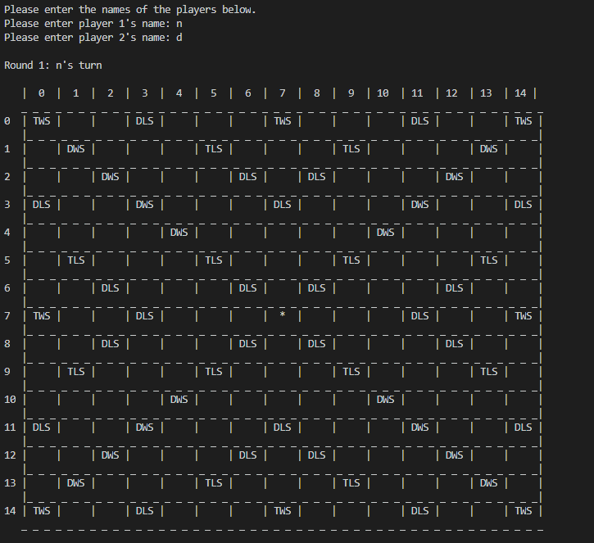
AFTER INITIALIZATION OUR GAME LOOKS LIKE THIS
https://github.com/sh06036/DSA-Scrabble-Fall2020

